Slide 1
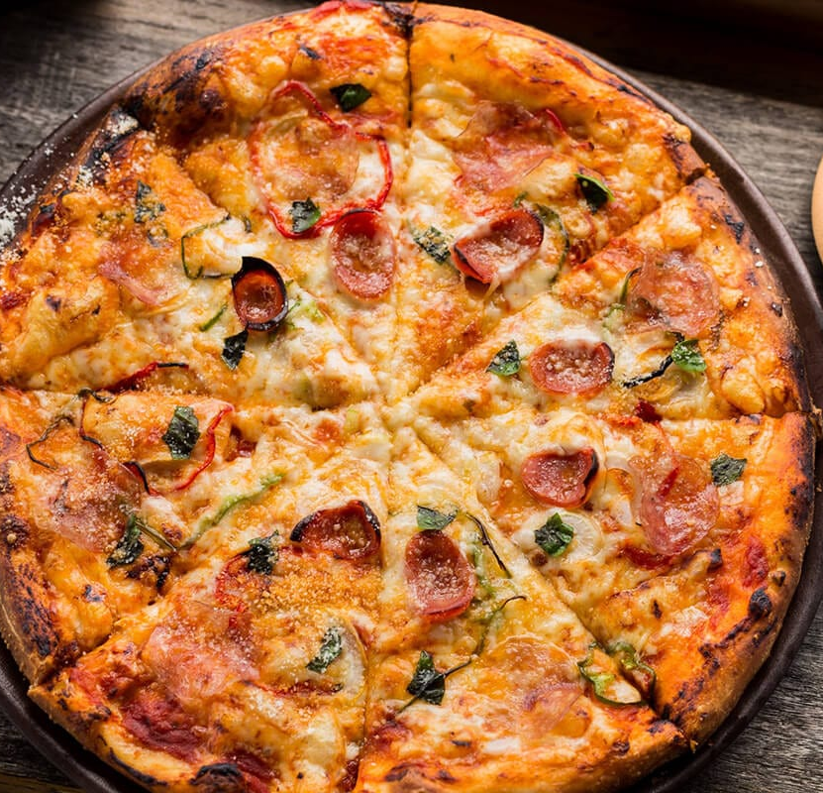
Chennai’s Best Pizza
Make memories forever…
Performance Report FY 2021-22
Branch - Marina Beach
Sales Report
Performance Highlights
KPI
Dated: April 19, 2022

Slide 2
Notes:
Maximum profit was observed in the Q4.
Optimization of Delivery and live tracking system helped for increased profits.
Post pandemic, increase in labor, operational and fuel costs resulted in higher expenses.

Slide 3
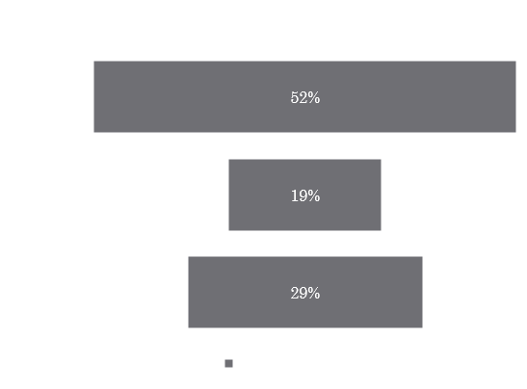
Performance Highlights
Customer Reviews
3.6
4
4.3
4.7

Slide 4
KEY PERFORMANCE INDICATORS
Metrics | Description | Formula | Q1 | Q2 | Q3 | Q4
Cash Flow | Amount of Money going in and out of the restaurant | Cash Flow = Cash Input- Cash Output | 4L | 5.5L | 8L | 12L
Cost of Goods Sold | The cost required to create food and beverage items sold to guests | COGS = Beginning Inventory + Purchased Inventory - Final Inventory | 12L | 14L | 17L | 20L
Prime Cost | Operating Cost of the restaurant | Prime Cost = Total COGS + Total Labor | 20L | 22L | 26L | 30L
RevPASH | Revenue Per Available Seat Hour during a given time period | RevPASH = Total revenue / (available seats x opening hours) | 40,000 | 52,000 | 70,000 | 90,000
Repeat Visitor Rate | Customer Retention rate | Retention Rate = ((Number of customers at end of period - Number of new customers acquired during that period) ÷ number of customers at start of period)) x 100 | 60% | 71% | 76% | 83%
Delivery Time | Delivery Time for Online Booking | Delivery Time = Order Delivered Timestamp – Ordered Timestamp | 45 min | 43 min | 37 min | 29 min
Thank you and Always happy to serve you
with best quality!

